Slide 1
Generative Models
Dr. Konda Reddy Mopuri
Dept. of AI
IIT Hyderabad

Slide 2
Typical (broad) categorization of ML tasks
Supervised
Unsupervised
Driving data: samples x
No labels
Learn ‘some structure’ from the data
E.g. Clustering, Dimensionality Reduction, Feature Learning, Density Estimation, etc.
Driving data: samples (x,y)
x is data, y is its label
Aim: mapping function x → y
E.g. Classification, Regression, Object Detection, Semantic Segmentation, etc.

Slide 3
Another categorization
Discriminative vs. Generative Models

Slide 4
Generative vs. Discriminative
Discriminative
Generative
Learn the boundaries between the classes
Learns p(y/x)
Model the distribution of individual classes
Learns p(x)
Conditional Generative models learn p(x/y)

Slide 5
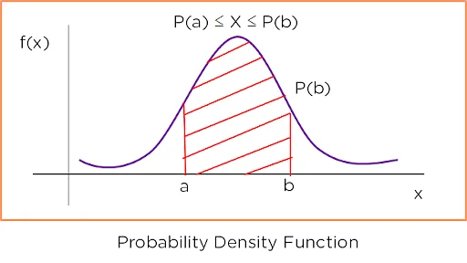
Probability density function (PDF)
Function on the sample space that indicates relative likelihood of the random variable
Non-negative function
Normalized to 1 (AUC)
→ Different values of random variable (x) compete for the density
Discrete random variable → PMF
Figure Credits: simplilearn

Slide 6

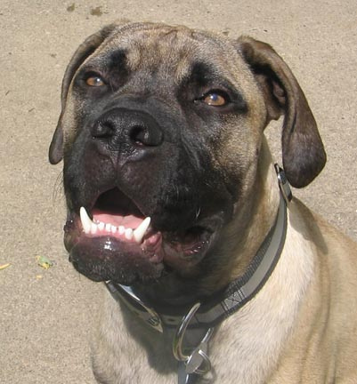
Generative vs. Discriminative
Discriminative
Learns p(y/x)
Competition among the set of labels for each input (not across inputs)
p(dog/x)
p(cat/x)
p(tiger/x)
x
p(dog/x)
p(cat/x)
p(tiger/x)
x

Slide 7
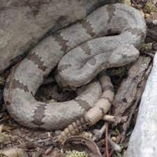
Generative vs. Discriminative
Discriminative
Must predict labels for any input
p(dog/x)
p(cat/x)
p(tiger/x)
x

Slide 8
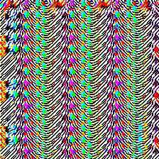
Generative vs. Discriminative
Discriminative
Can’t reject inputs!
p(dog/x)
p(cat/x)
p(tiger/x)
x

Slide 9
Generative vs. Discriminative
Generative
Learns p(x)
Competition is among different samples
p(cat)
p(dog)
p(snake)
p(garbage)
Requires a great understanding of the images.
How likely for a snake to be on the ground? Or, in the air? Or, next to a human?

Slide 10
Generative vs. Discriminative
Generative
Learns p(x)
Competition is among different samples
p(cat)
p(dog)
p(snake)
p(garbage)
Importantly, the model can reject unreasonable samples as ‘unlikely’ (small value assignment)

Slide 11
Generative vs. Discriminative
Conditional Generative
p(x/cat)
Learns p(x/y)
Conditioning label results in competition among different samples
p(x/dog)

Slide 12
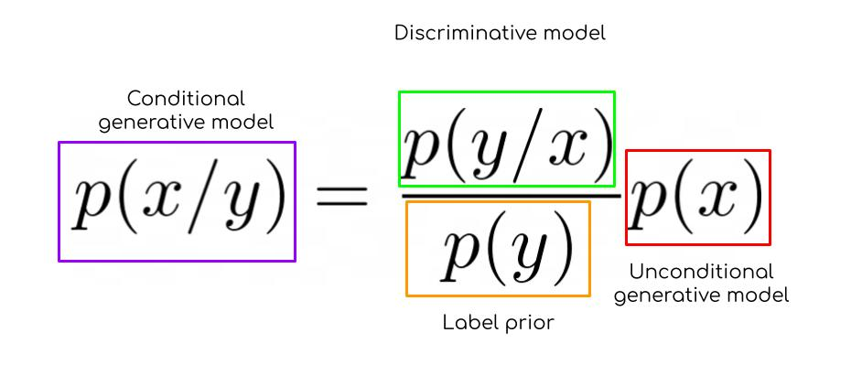
Generative vs. Discriminative
Conditional generative models can be built from other components!

Slide 13
Summary
Discriminative p(y/x) → assign labels, feature learning (with labels)
Generative p(x) → Detect outliers, feature learning (w/o labels), and sample to generate new data!
Conditional p(x/y) → Assign labels and detect outliers, Generate new data conditioned on the label!

Slide 14
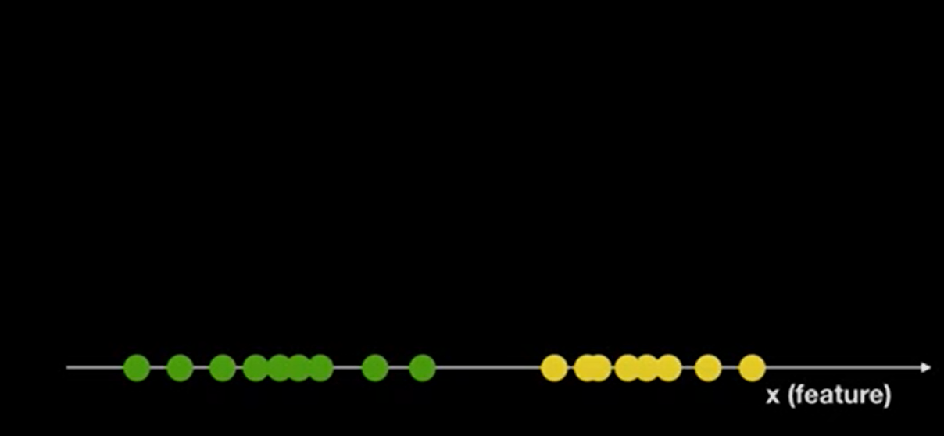
Example

Slide 15
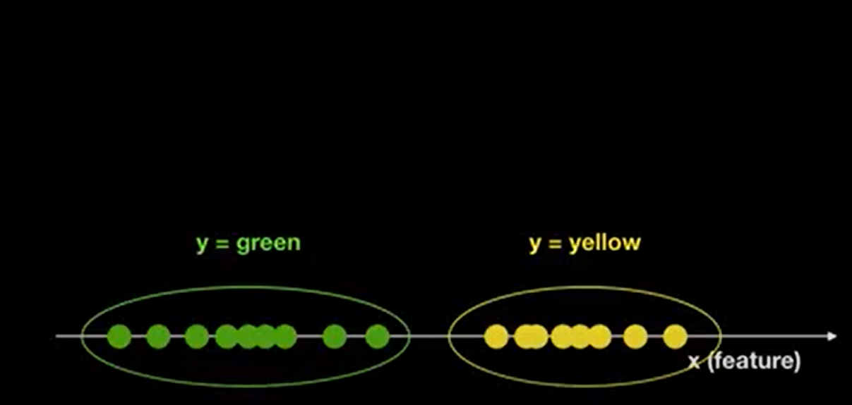
Conditional Generative Model
Given data, model estimates distribution of p(x/y)

Slide 16
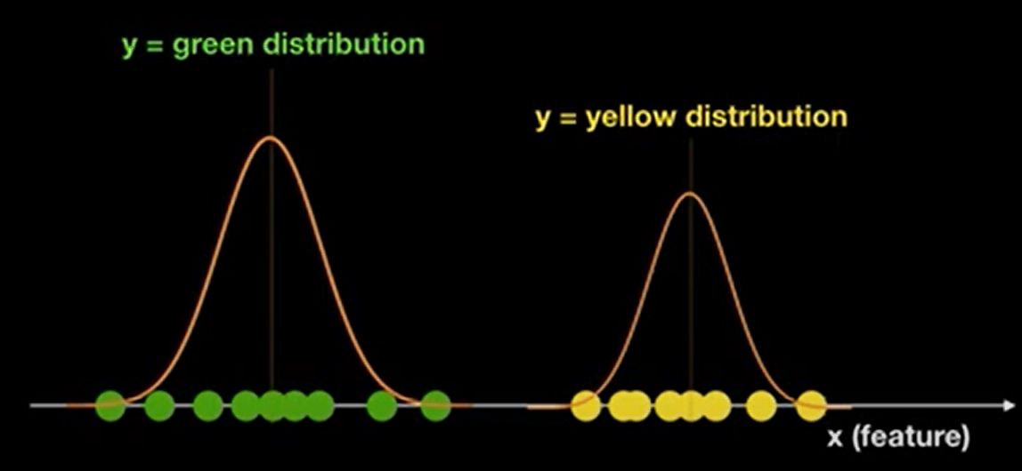
Conditional Generative Model
Given data, model estimates distribution of p(x/y)

Slide 17
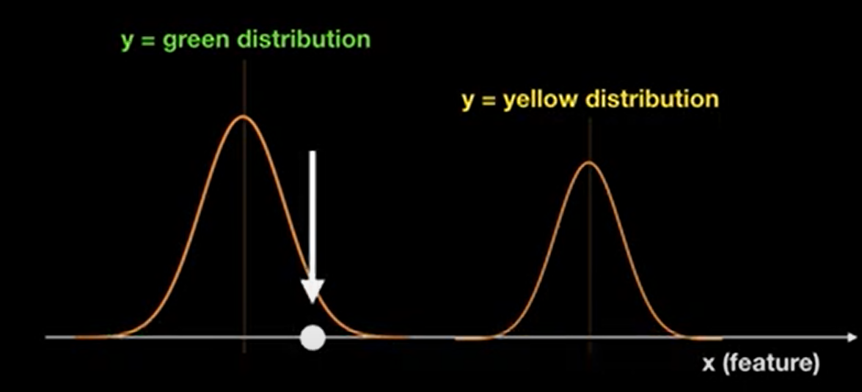
Conditional Generative Model
What is the value of y for new data?

Slide 18
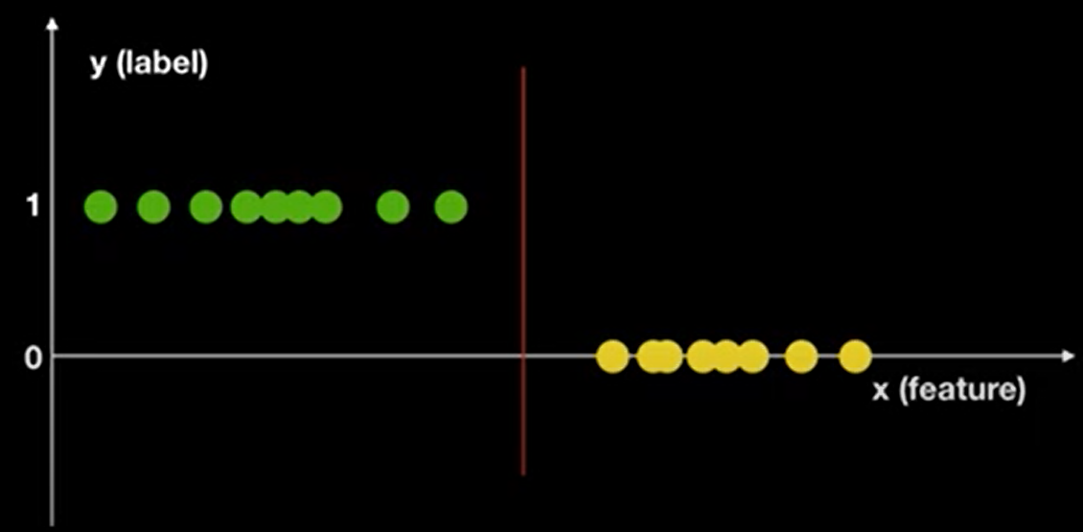
Discriminative Model
Focus is on ‘How to distinguish different classes?’
Goal is to find the decision boundary

Slide 19
Discriminative Model
Focus is on ‘How to distinguish different classes?’
Goal is to find the decision boundary
Uses p(y/x) to classify → predicts the class with highest p(y/x)

Slide 20
Broad categorization of Generative Models
Model can’t compute p(x), but can sample from it
Model can compute p(x)
Generative Models
Explicit Density
Implicit Density
GANs
Tractable
Approximate
Autoregressive models
Variational
Markov Chain
VAE
Boltzmann machine

Slide 21
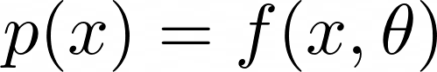
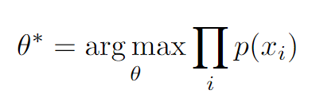
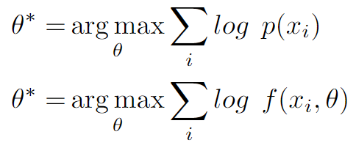
Models with Explicit Density
Given the training data {x₁, x₂, …. x_{N}}, train the model via maximum likelihood estimation (MLE)

Slide 22
Autoregressive models
Based on the assumption that sample x consists of multiple portions (subparts) → x = (x₁, x₂, x₃, ….. x_{W})
Probability is expressed using the chain rule
p(x₁, x₂, x₃, ….. x_{W}) = p(x₁) p(x₂/x₁)p(x₃/x₂,x₁)...... = 𝛱 p(x_{t}/x₁x₂ … x_{t-1})
→ Recurrent models (RNNs) can do this!

Slide 23
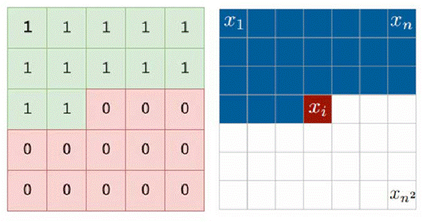
Autoregressive models: Pixel RNNs (ICML 2016)
Generate the pixels of an image: one at a time, from top-left to bottom right
Hidden state of each pixel is modeled from the hidden state and pixel values of left and top pixels

Slide 24
Autoregressive models: Pixel RNNs (ICML 2016)
Very slow during both training and testing!

Slide 25
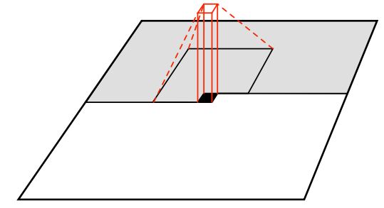
Autoregressive models: Pixel CNNs (NeurIPS 2016)
Dependency is modeled with a CNN over the context
Training MLE
Training is faster but sampling is slow

Slide 26
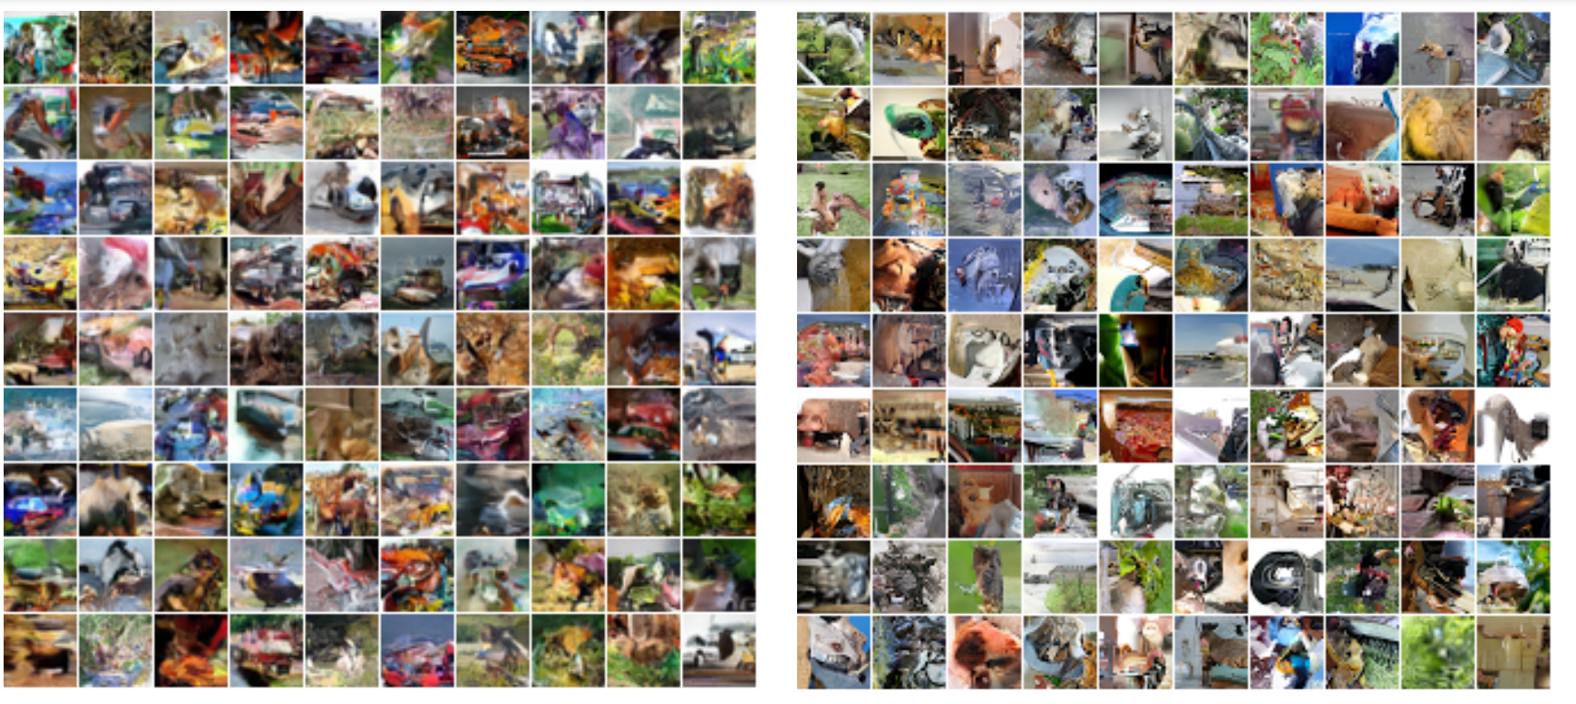
Pixel RNN results
CIFAR-10 (32 X 32)
ImageNet (32 X 32)

Slide 27
Broad categorization of Generative Models
Model can’t compute p(x), but can sample from it
Model can compute p(x)
Generative Models
Explicit Density
Implicit Density
GANs
Tractable
Approximate
Autoregressive models
Variational
Markov Chain
VAE
Boltzmann machine

Slide 28
Variational Autoencoders (VAE)

Slide 29
VAE
Deal with an intractable density → can’t be computed/optimized explicitly
Optimizes the ‘lower bound’ on the density

Slide 30
Next: VAEs

